Slide 1
AZ-900T0x Module 01: Cloud concepts
Ravindra Kudache
Notes:
Adjust the title page for AZ-900T00 or AZ-900T01.

Slide 2

Module Outline

Slide 3
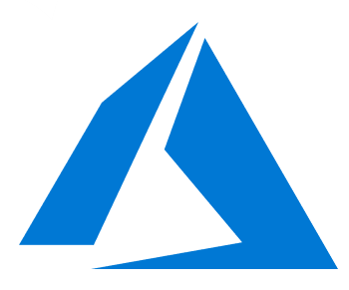
Module 01 - Outline
You will learn the following concepts:
Cloud Network
Cloud Storage

Slide 4
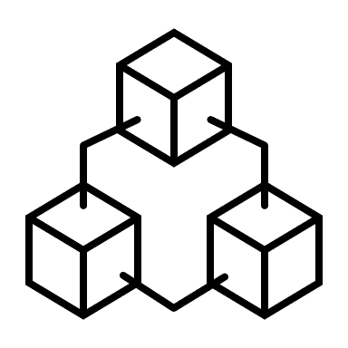
Cloud Models

Slide 5
D e s c r i b e A z u r e a r c h i t e c t u r e a n d s e r v i c e s - N e t w o r k i n g

Slide 6
Virtual Network

Slide 7

Virtual Network
Isolated This is an isolated network on Azure cloud.
1
Resources
3
You can then place resources such as Azure virtual machines within the virtual network.
Managed
Here you don’t need to deploy an infrastructure to have a network in place.
2
Internet
By default all resources in the virtual network can communicate outbound with the internet.
Virtual Network
4

Slide 8
Security Groups

Slide 9


This is used to filter network traffic in an Azure virtual network.
You define different rules as part of the Network Security Group. You have Inbound and Outbound rules.
For each rule you mention the source and destination of traffic, the port and protocol.
Security Groups

Slide 10
This is used when you want to apply network filtering rules for a group of machines.
Instead of mentioning the IP address of the machine, you can make the machine part of an Application Security Group.
And then you can mention the Application Security Group in the Network Security Group.
Security Groups

Slide 11
Connectivity

Slide 12

An Azure VPN gateway can be used to send encrypted traffic between an Azure virtual network and on- premises location over the Internet.
Point-to-Site VPN – This let’s you create a secure connection from the Azure virtual network to an individual client computer.
Site-to-Site VPN – This provides connectivity between an on-premises network and an Azure virtual network.
Connectivity

Slide 13
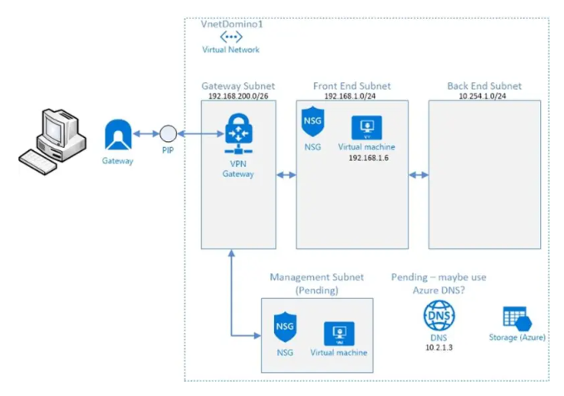
Point To Site

Slide 14
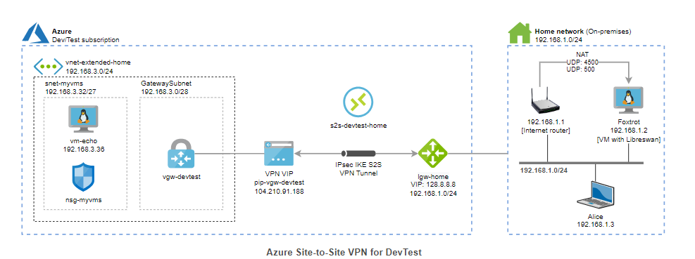
Site 2 Site

Slide 15
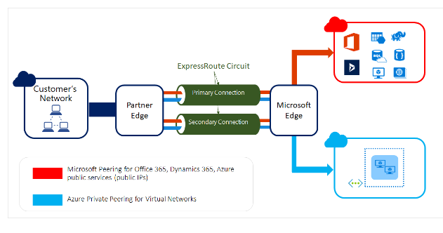
Express Route
Notes:
Extends on-premises networks into the Microsoft Cloud over a private connection.Involves a connectivity provider, which could be an internet service provider (ISP).

Slide 16
Azure Load Balancer

Slide 17
This service is used to distribute the incoming network traffic across a group of backend resources of servers
You can define two types of load balancers – Public or Private Load Balancers
You have 2 SKUs for the Load Balancer – Standard and Basic Load Balancer
Azure Load Balancer

Slide 18
Basic Load Balancer
Pricing
You are not charged for the Load Balancer
SLA
There is no SLA
Features
Azure Load Balancer
Backend machines
Here the machines need to be part of an availability set
or scale set
Support for zones
There is no support for availability zones

Slide 19
Standard Load Balancer
Pricing
There is a price per hour
SLA
There is an SLA of 99.99%
Features
Azure Load Balancer
Backend machines
Here the machines need to be part of an availability set or scale set or they can be individual machines
Support for zones
Here you get support for availability zones

Slide 20
Components of a Load Balancer
Frontend IP
Backend pool
Health probes
Rules
Azure Load Balancer
Here you define an IP address for the load balancer
This contains the backend virtual machines
This helps to check the status of the backend pool
The Load Balancing rules define how to distribute the incoming traffic

Slide 21



Azure networking services
Azure Virtual Network (VNet) enables Azure resources to communicate with each other, the internet, and on-premises networks.
Virtual Private Network Gateway (VPN) is used to send encrypted traffic between an Azure virtual network and an on-premises location over the public internet.
Azure Express Route extends on-premises networks into Azure over a private connection that is facilitated by a connectivity provider.

Slide 22
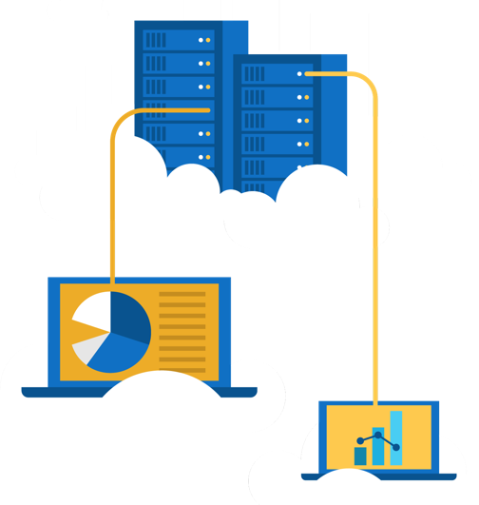
Walkthrough - Create a virtual network
Create a virtual network with two virtual machines and then test connection between the machines.
Create a virtual network.
Create two virtual machines.
Test the connection.

Slide 23

Module 02 Review
Microsoft provides more global presence than any other cloud provider with over 60 regions distributed worldwide
Azure Management tools
Azure's multiple services ( networking, storage)
Azure Marketplace
Microsoft Learn Modules (docs.microsoft.com/Learn)
Notes:
https://docs.microsoft.com/en-us/learn/paths/azure-fundamentals/

